Slide 1

Spotify
Building a popularity predictor from 2020 Spotify data
Popularity predictor

Slide 2
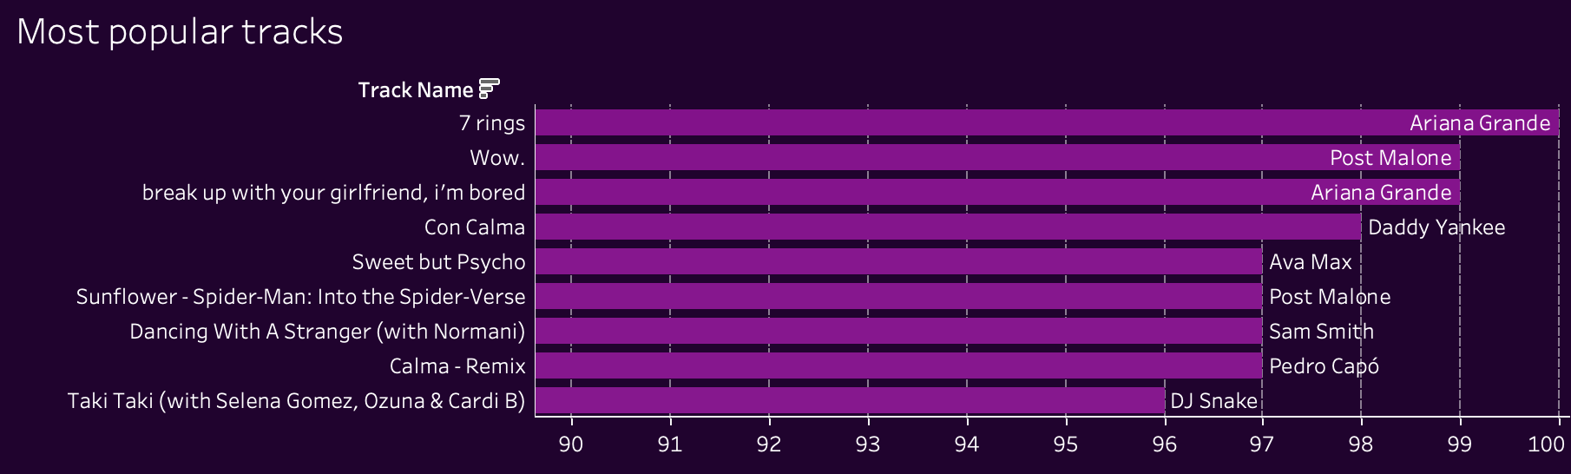
What makes a track popular?

Slide 3

CONTENTS
Dataset
exploration
Feature selection
model

Slide 4
Dataset
The Spotify Tracks DB is a music database consisting of approximately 232,725 tracks. The dataset has been cleaned, and specific features such as key, mode, and time signature have been standardized. The dataset includes tracks from 26 different genres, with approximately 10,000 tracks per genre.

Slide 5
columns
genre
artist_name
track_name track_id
popularity acousticness danceability duration
energy instrumentalness key
liveness
Loudness
mode
speechiness tempo time_signature valence
I used tableau to explore some of the interesting relations the data had to offer
exploration

Slide 6
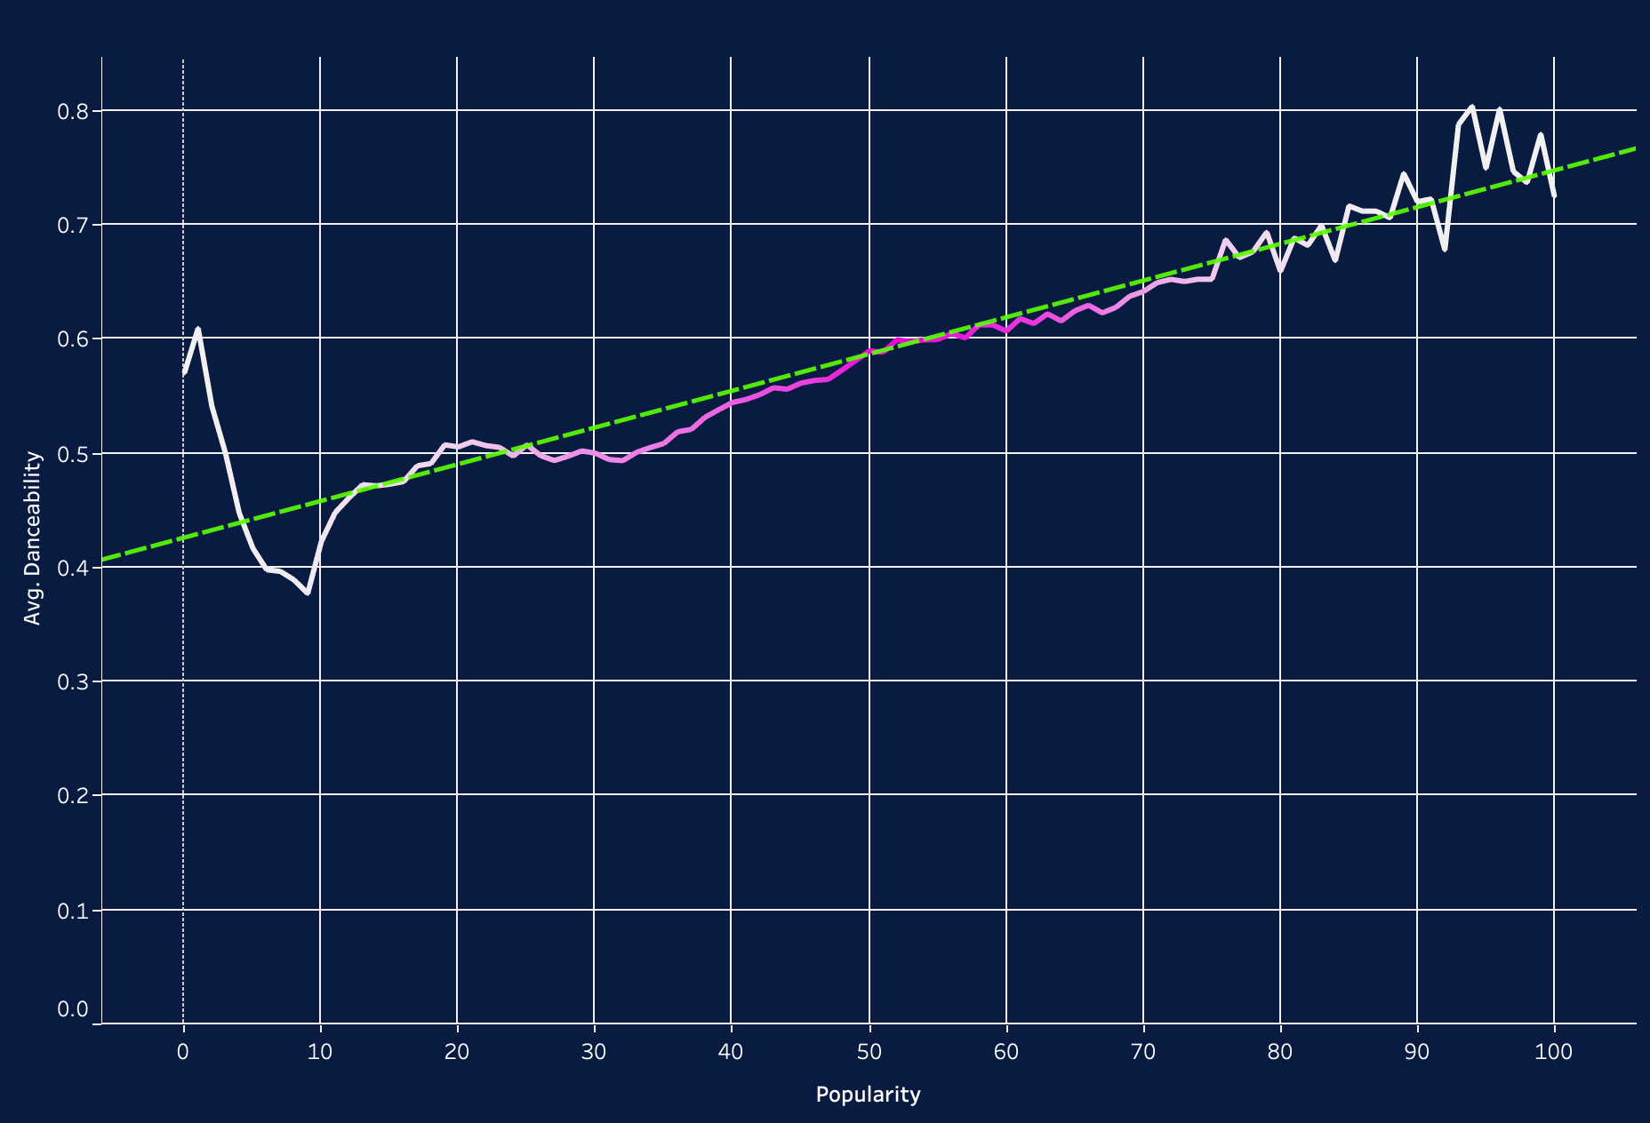
Danceability
R-Squared: | 0,880413
Standard error: | 0,0348924
p-value (significance): | < 0,0001

Slide 7
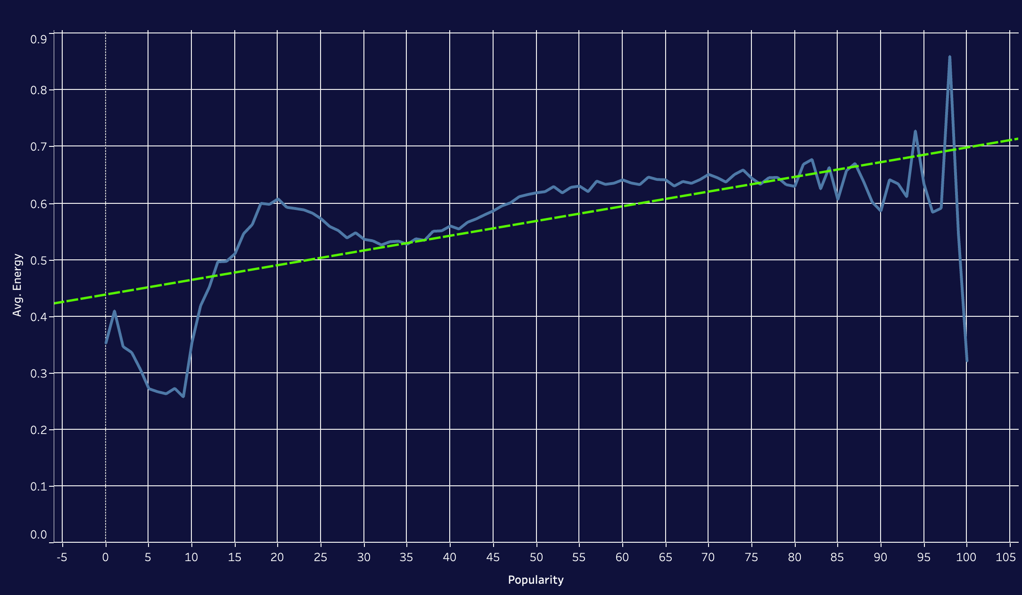
Energy
R-Squared: | 0,477161
Standard error: | 0,0801542
p-value (significance): | < 0,0001

Slide 8
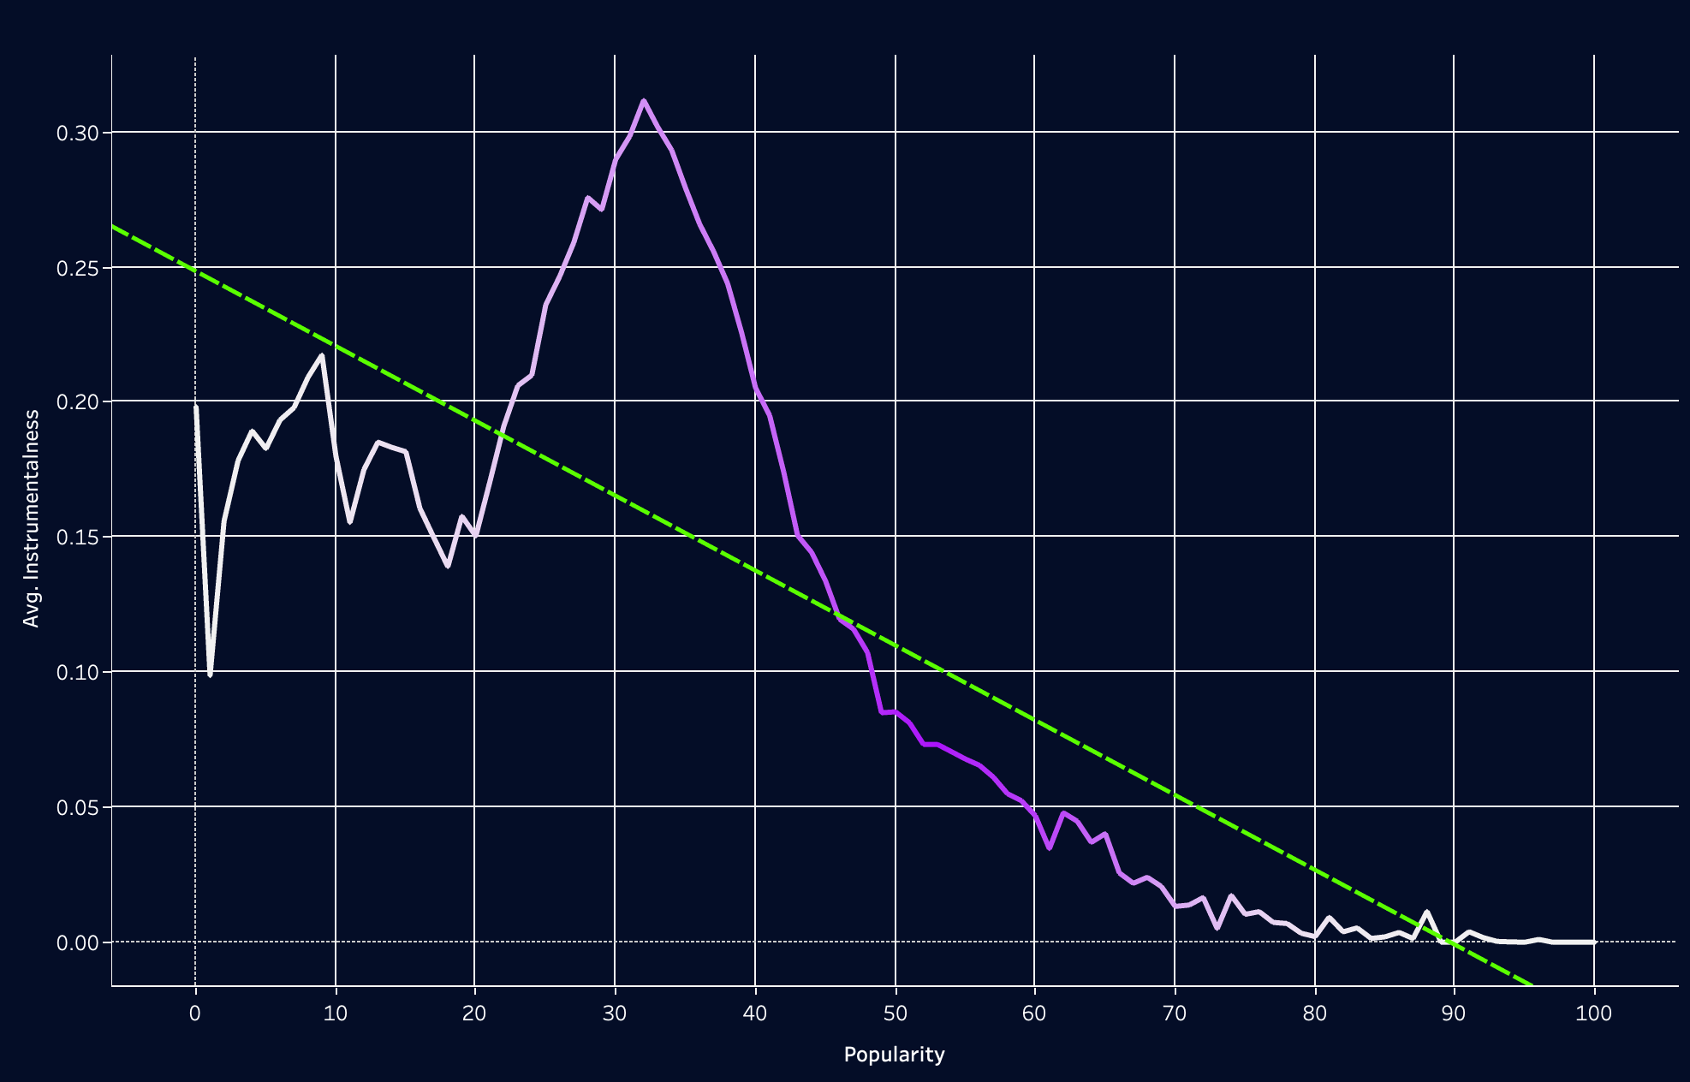
Instrumentalness
R-Squared: | 0,68163
Standard error: | 0,0557605
p-value (significance): | < 0,0001

Slide 9
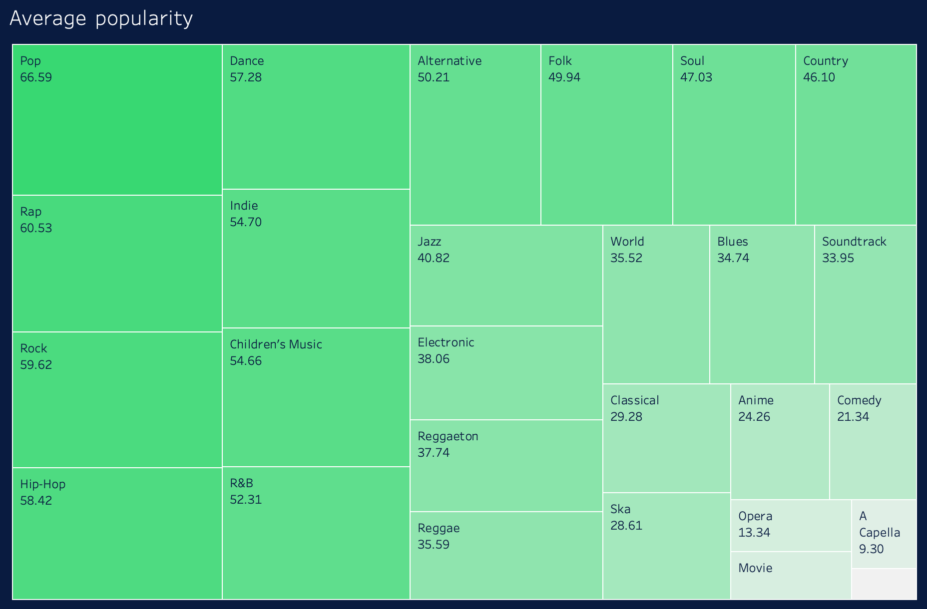
genre

Slide 10
goal
Explore and which factors are key in determining a song’s popularity and develop an early model to predict a song’s popularity

Slide 11
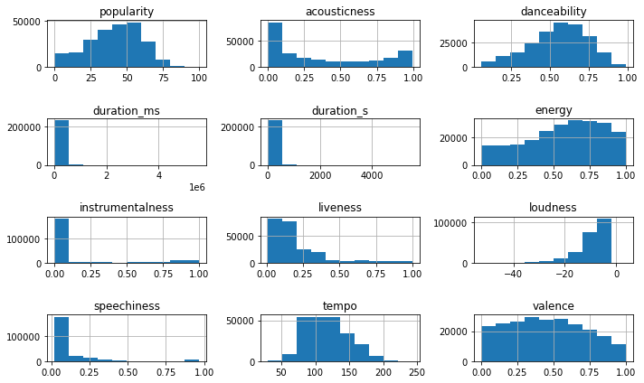
Data preprocessing
Dataset mostly clean
No Null Values
Did not find multicollinearity
Few outliers

Slide 12
Feature selection
 | Linear Regression | K-Neighbors | MPL-Regressor
First attempt | 0.11 | 0.07 | -0.47
After removing all columns with <10% corr | 0.22 | 0.56 | 0.44
After removing all columns with <20% corr | 0.22 | 0.58 | 0.48

Slide 13
protorype
Genre
Acousticness
danceability
instrumentalness
energy
Loudness
The K-neighbors model with k=11 yielded the best results.
All data is normalized as numbers between 0 and 1

Slide 14
Genre Cheat sheet
0
0.23077
0.26923
0.30769
0.34615
0.38462
0.42308
0.46154
0.5
0.53846
0.57692
0.61539
0.65385
0.69231
0.73077
0.76923
0.80769
0.84615
0.88462
0.92308
0.96154
1
0.03846
A Capella
0.07692
Alternative
0.11539
Anime
0.15385
Blues
Children's Music
Classical
Comedy
Country
Dance
Folk
Electronic
Hip-Hop
Indie
Jazz
Movie
Opera
Pop
R&B
Rap
Reggae
Reggaeton
Rock
Ska
Soul
Soundtrack
World

Slide 15



To do
dataset
There are other Spotify datasets which include further information that could be incorporated into the current model
MODEL
Further developement
The K-neighbors model used is not ideal, since it only accounts for about 60% of all variation in the dataset.
Make detailed explanations for each measure
App
The app should be able to receive unnormalized data and song genres “as is” and process the data itself
The app should work as a standalone

Slide 16
Thank you for your attention

